Slide 1

DEPARTMENT OF COMPUTER SCIENCE AND ENGINEERING
NOISE POLUTION MONITORING
Team name : Proj_224788_team_3
TEAM MEMBERS:
JANANI.V.V (113321104031)
JAYAPREETHA.S (113321104033)
JAYASRI.M (113321104034)
KAMIREDDY CHARITHA (113321104035)

Slide 2
PROBLEM DEFINITION
IoT allows an exchange of information to and from a device or thing and due to its flexibility and low cost, IoT is getting popular day by day .
Thus, IoT is very suitable to be implemented in monitoring the noise level in some areas to deal with the problem.
The demands of modern society lead to the creation of noise sources such as industrial sources, transport vehicles, defence equipment and construction.
The most significant example is inside UTM. Noise coming from vehicles and construction sites have significantly distract the focus and the intellectual development of the students.
This issue results in the needs of a system that will monitor the noise level at that specified areas. It is also an alternative for students to know the suitability to study via app.

Slide 3
OBJECTIVES
TO REGULATE AND CONTROL NOISE
PRODUCING AND GENERATING SOURCES
SOURCE IDENTIFICATION
DATA-DRIVEN DECISION MAKING
ACCURACY AND PRECISION
THRESHOLD ALERTS
ENVIRONMENTAL IMPACT REDUCTION
SAFETY AND SECURITY
DATA AGGREGATION
REAL TIME NOISE DATA
ENHANCED ACCESSIBILITY

Slide 4
PROJECT REQUIREMENTS
IoT Noise Sensors: Choose IoT noise sensors designed for environmental monitoring.This sensor is equipped with built-in microphones and connectivity options and capable of collecting noise data and transmitting it over the internet.
High-Quality Microphones: Use sensitive, calibrated microphones capable of capturing a wide range of frequencies and low self-noise. This is crucial for accurate noise measurement.
Power Source: Depending on the location, select IoT devices that can be powered by batteries, solar panels, or mains power.
User Interface: Consider the need for user-friendly interfaces for operators to configure, monitor, and access data.
Data Retention and Backup: Determine data retention policies and implement backup solutions to prevent data loss
Connectivity: Select IoT sensors that offer multiple connectivity options, such as Wi-Fi, cellular, LoRa, or even Bluetooth, depending on the deployment location and data transmission requirements.
API Integration: Ensure that the IoT sensors and cloud platform offer API integration for potential integration with other systems or data sources.

Slide 5
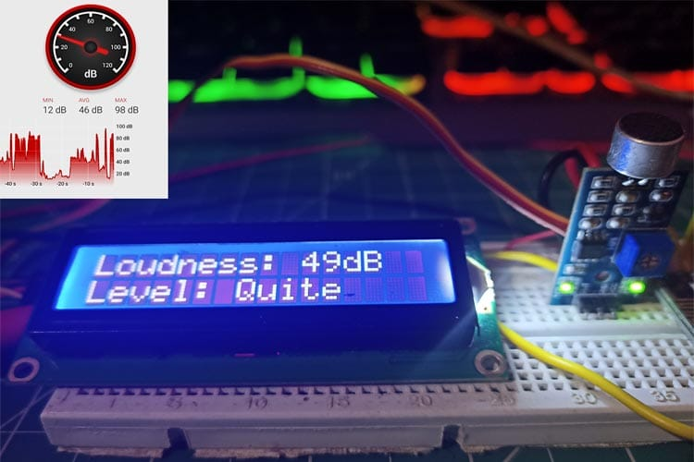
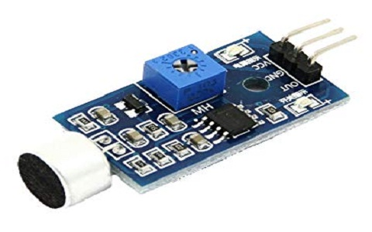
DEVICE SELECTION
The sensor module provide an easy way to detect sound and it generally used for detecting sound intensity.module detect that sound has exceeded a threshold value.
Sound is detected vai microphone fed into an LM393 opamp.the soynd level adjust through pot.
The sound increases set value output is low.these module work on DC 3.3-5 voltage.
Feature:
Output voltage 3.3v-5v
Output model:didital switch output(0 and 1,high or low level)
Voltage gain 26dB
Micrphone impendance 2.2kΩ
Microphone frequency 16.20kHz

Slide 6
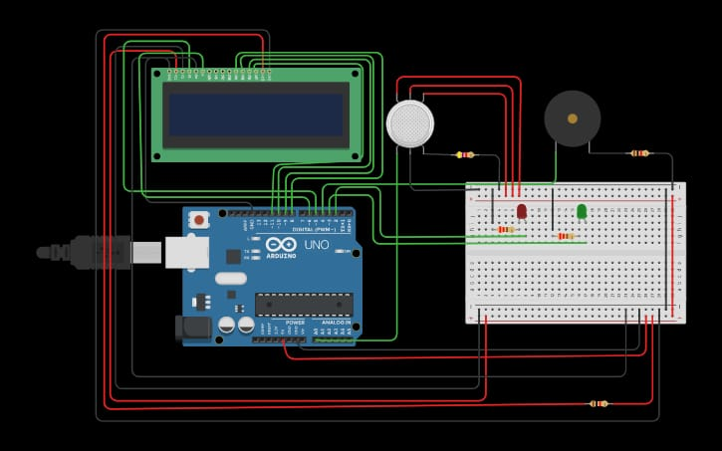
ARDUINO INTEGRATION

Slide 7

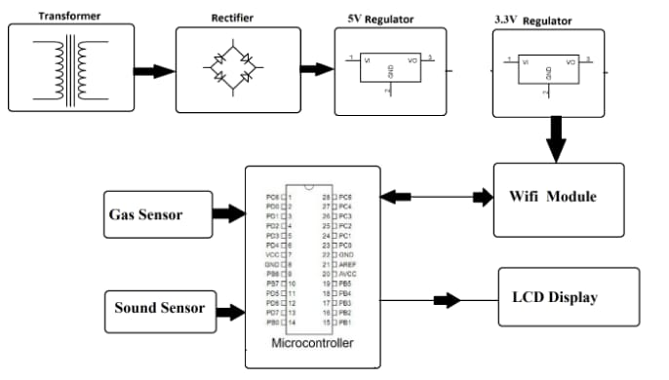
RASPBERRY PI INTEGRATION
An IOT-based method using RasberryPi is used to monitor and check live the sound pollution of a region.

Slide 8
CODE IMPLEMENTATION
HARDWARE REQUIREMENTS
SOFTWARE REQUIREMENTS
Atmega Microcontroller
MQ 135 Sensor
Mic Sensor
ESP8266 Wifi Module
LCD Display
CrystalOscillator
Resistors
Capacitors
Transistors
Cables and Connectors
Diodes
Pcb and switch
Arduino specification
Mc programming language:c
Iotgecko

Slide 9
PYTHON SCRIPT DEVELOPMENT
On IoT Devices:-
On Central Server:-
User
ChatGPT
Select the ioT hardware
Noise sensor
Connectivity
Install python
Data collection
Data processing
Data transmission
Remote monitoring
Data storage
Alerting
Power Management
Security
Testing

Slide 10
CONCLUSION
People thought that noise pollution is merely an annoyance but it is actually very important to monitor noise level because according to research, people who are exposed to noise for a long duration of time can have hearing loss, sleep disturbance, high blood pressure and injuries .

Slide 11
THANK YOU

